Slide 1
Penn State Strategic Plan
Implementation Update
Dr. Nicholas P. Jones
Meeting of the Quality Advocates Network
Thursday, December 1, 2016
Office of the Executive Vice president and provost
Notes:
Thank you, Betty, for that kind introduction, and good afternoon. Thank you for participating in this meeting of the Quality Advocates Network. Today, I will be discussing Penn State’s strategic plan and, in particular, how we are proceeding to implement it University-wide. It is an immense but essential endeavor, and one I think is important to discuss with all Penn State constituents, here at University Park and our other campuses across the Commonwealth.
While my principal focus today is on plan implementation, I’ll start by providing some contextual information to get everyone back up to speed on why this all matters and how we got to this point. I’ll also briefly cover the plan’s components and content, which are driving how we approach implementation.
I will allow ample time for questions and comments after my presentation, and I hope you are eager to engage. This is a great opportunity for you to not only to ask questions, but also to offer your ideas and suggestions about how we should proceed. Successful implementation of our strategic plan will depend on constructive feedback from stakeholders throughout the University, and your participation in this meeting comes near the beginning of a multi-year process.

Slide 2
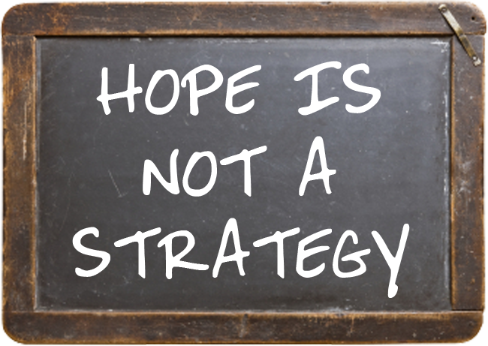
University Strategic Planning:
Why It’s Still Essential
Rapidly evolving trends require more critical assessments and innovative thinking.
Strategic plans cannot be static; adaptability and agility are critical to success.
All universities plan. But it’s how they plan, and then implement their plans, that makes the difference between progress and stagnation.
OFFICE OF THE EXECUTIVE VICE PRESIDENT AND PROVOST
Notes:
Strategic planning has paved the way for Penn State's ascension among the ranks of the world’s great research universities. Since the 1980s, Penn State has engaged in strategic planning to strengthen its ability to make careful, informed choices, and to allocate resources according to evidence, judgment, and long-term priorities.
And, while it’s nice to be hopeful, sitting back and hoping for the best is not a strategy. Simply put, planning matters, and strategic planning for universities is perhaps more vital now than ever before. Our fast-changing world requires that we break free of static plans and become more agile and adaptive. Rapidly evolving trends in higher education call for us to think more critically and innovatively as we move forward.
Consider how much has changed across the University in only the past 20 to 25 years. Our culture of constant innovation requires continuous planning and assessment to ensure we deliver what our students and other key stakeholders demand.
Where will we focus our efforts? What capabilities will we need? How will we succeed, and what will success look like for Penn State as a whole, as well as for all of its many parts? These are among the many questions we must address.
All universities plan. But it’s how they plan, and then implement their plans, that ultimately makes the difference between progress and stagnation. We are actively pursuing the former, and as a result avoiding the latter.

Slide 3
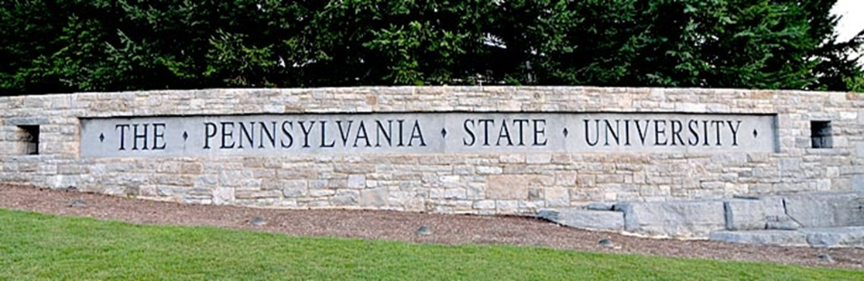
“Our Commitment to Impact” strategicplan.psu.edu
OFFICE OF THE EXECUTIVE VICE PRESIDENT AND PROVOST
Notes:
Penn State’s planning process operates on a five-year cycle and has three primary components: integrated planning, Unit-level planning, and University-level planning. So, contributions from all of you and many others were integral to developing our University-wide strategic plan for 2016 through 2020, titled “Our Commitment to Impact.” The document is available online at strategicplan.psu.edu.

Slide 4
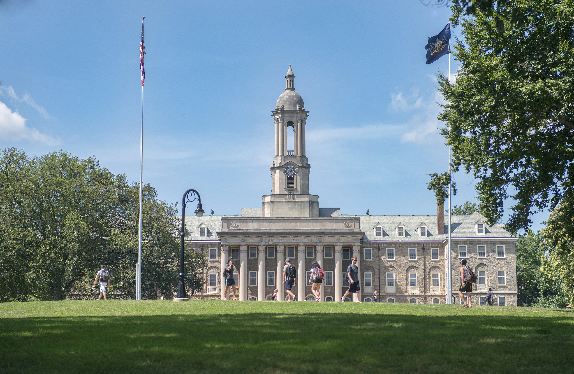
How Our Plan Came Together
Penn State’s strategic plan was published in February 2016 after
an inclusive two-year process.
Planning in 48 academic and administrative units drove development of the new University-wide plan, which identifies priorities and goals
for 2016-2020.
OFFICE OF THE EXECUTIVE VICE PRESIDENT AND PROVOST
Notes:
Published in February 2016 after a broad and inclusive two-year process, our strategic plan identifies Penn State’s goals at a macro level and sets a firm foundation for their pursuit during the next four years. It’s based on the strategic plans developed in 48 academic and administrative units throughout the University.

Slide 5
The Plan’s Core Components
The Fundamentals
Penn State’s vision and mission statements, and institutional values
Six Foundations
Integral to all that we do and everyone’s responsibility to sustain
Five Thematic Priorities
Key areas of strength and growth in teaching, research, and service
Potential for meaningful impacts in the Commonwealth and beyond
Three Supporting Elements
Pieces of equal importance required to achieve desired outcomes
OFFICE OF THE EXECUTIVE VICE PRESIDENT AND PROVOST
Notes:
Our University-wide plan includes several core components, starting with Penn State’s official vision and mission statements, and articulation of our institutional values.
The foundations are areas we consider integral to all we do, and sustaining them is the responsibility of everyone at Penn State.
The thematic priorities align with our focus on strength and growth in teaching, research, and service, three areas where Penn State is well situated to make significant impacts in the Commonwealth and beyond.
The three supporting elements are pieces that must function optimally if we want to achieve our goals.

Slide 6
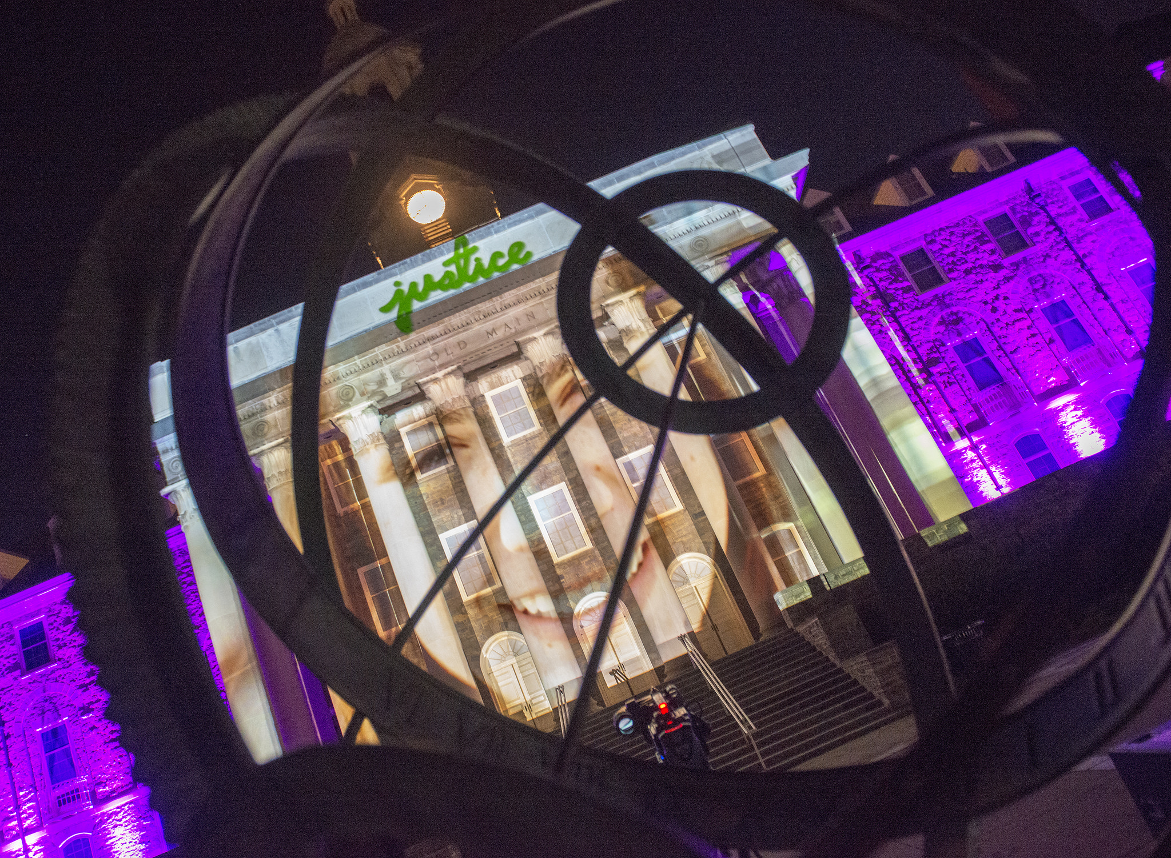
Penn State’s Vision Statement
“Penn State will be a leader
in research, learning, and engagement that facilitates innovation, embraces diversity and sustainability, and inspires achievements that will affect the world in positive and enduring ways.”
OFFICE OF THE EXECUTIVE VICE PRESIDENT AND PROVOST
Notes:
Penn State’s Vision Statement is the official articulation of our institutional aspirations: That “Penn State will be a leader in research, learning, and engagement that facilitates innovation, embraces diversity and sustainability, and inspires achievements that will affect the world in positive and enduring ways.”

Slide 7

Penn State’s Mission Statement
“Penn State is a multi-campus,
land-grant, public research University that educates students from around the world, and supports individuals and communities through integrated programs of teaching, research, and service.”
OFFICE OF THE EXECUTIVE VICE PRESIDENT AND PROVOST
Notes:
Our Mission Statement is slightly different, reaffirming what Penn State is and what we are all here to do, right now. Simply put, “Penn State is a multi-campus, land-grant, public research University that educates students from around the world, and supports individuals and communities through integrated programs of teaching, research, and service.”

Slide 8
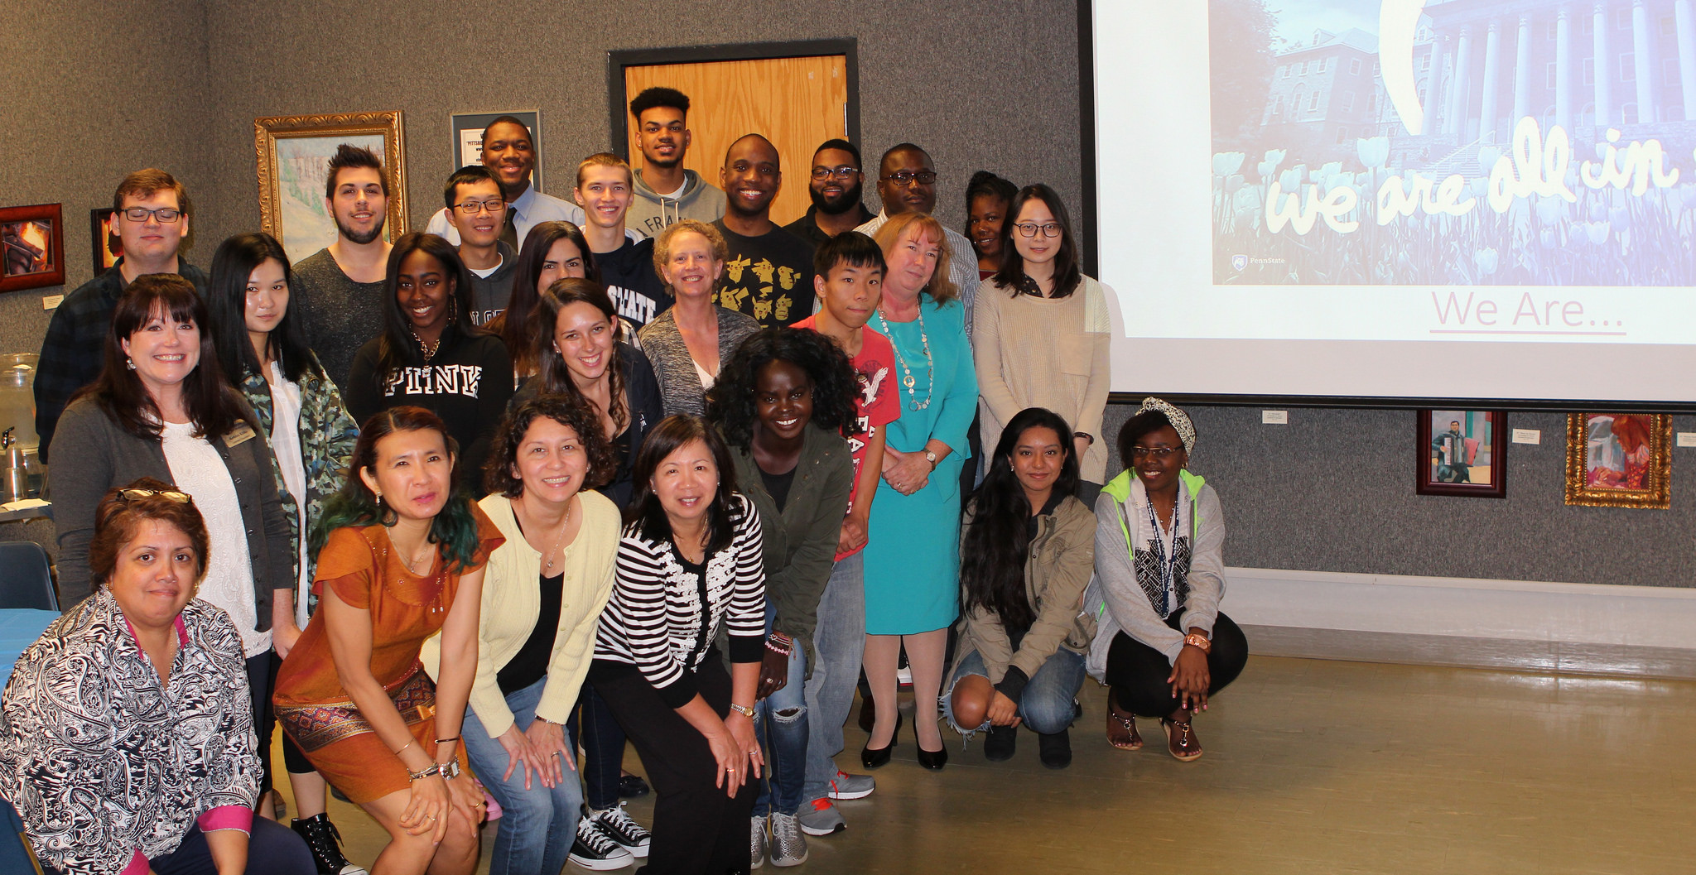
Penn State’s Institutional Values
Integrity
Respect
Responsibility
Discovery
Excellence
Community
OFFICE OF THE EXECUTIVE VICE PRESIDENT AND PROVOST
Notes:
Six core Institutional Values, identified in part through the Culture and Values survey conducted in 2014, sustain our strategic plan and offer essential context for the execution of Penn State’s mission. Those values are:
Integrity,
Respect,
Responsibility,
Discovery,
Excellence, and
Community.

Slide 9

The Plan’s Six Foundations
Enabling Access to Education
Engaging Our Students
Fostering and Embracing
a Diverse World
Enhancing Global Engagement
Driving Economic Development
Ensuring a Sustainable Future
OFFICE OF THE EXECUTIVE VICE PRESIDENT AND PROVOST
Notes:
We fortify our plan with six Foundations, which are integrated into everything the University does and critical to implementing the plan during the next four years. These foundations are not specific to certain programs, units, or segments of the University. Instead, they are imperatives for everyone and every part of Penn State, for which we all are responsible and accountable.
Everything we do must be built upon these foundations, which connect to our values as an institution. They are::
Enabling Access to Education,
Engaging Our Students,
Fostering and Embracing a Diverse World,
Enhancing Global Engagement,
Driving Economic Development, and
Ensuring a Sustainable Future.
We cannot deliver on these foundations — not to mention the University’s vision and mission — without the involvement of all Penn State stakeholders, including our staff members, faculty, administrators, and current and former students.

Slide 10
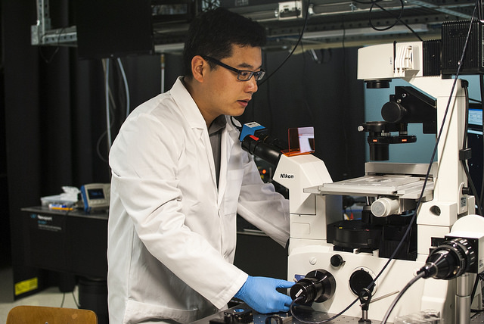
The Plan’s Five Thematic Priorities
Transforming Education
Enhancing Health
Stewarding Our Planet’s Resources
Advancing the Arts and Humanities
Driving Digital Innovation
OFFICE OF THE EXECUTIVE VICE PRESIDENT AND PROVOST
Notes:
The foundations support our five Thematic Priorities, which make up the proverbial “meat” of the strategic plan. They are:
Transforming Education,
Enhancing Health,
Stewarding Our Planet’s Resources,
Advancing the Arts and Humanities, and
Driving Digital Innovation.
Each priority represents a breadth and depth of expertise and interest across multiple Penn State units where the University is well positioned, with a strategic investment of resources, to have profound and measurable impacts. The themes intersect unit plans and draw from the human capital and programs they represent.
I should note that our five areas of thematic focus are not meant to exclude any other areas where we will continue to invest time and resources, such as our University’s vast research enterprise, education in STEM-related disciplines, and many others. They simply represent areas of unique opportunity during this five-year period, in addition to many things on which we already focus intently, with great success.

Slide 11
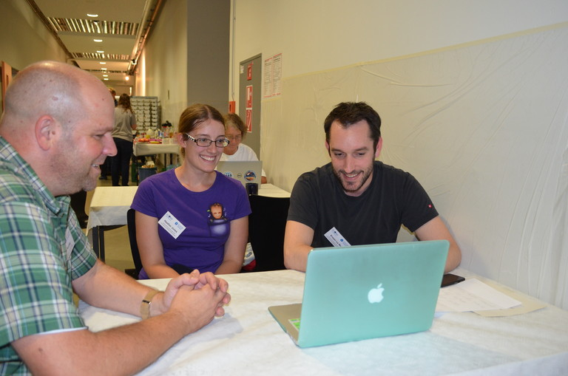
The Plan’s Three Supporting Elements / Functional Areas
Organizational Processes
Infrastructure and Support
Constituent Outreach and Engagement
OFFICE OF THE EXECUTIVE VICE PRESIDENT AND PROVOST
Notes:
This plan also identifies important Supporting Elements: functional areas that must be in place and operating optimally for Penn State to pursue its institutional imperatives and strategic priorities, and to support its mission and vision. They are:
Organizational Processes,
Infrastructure and Support, and
Constituent Outreach and Engagement.

Slide 12
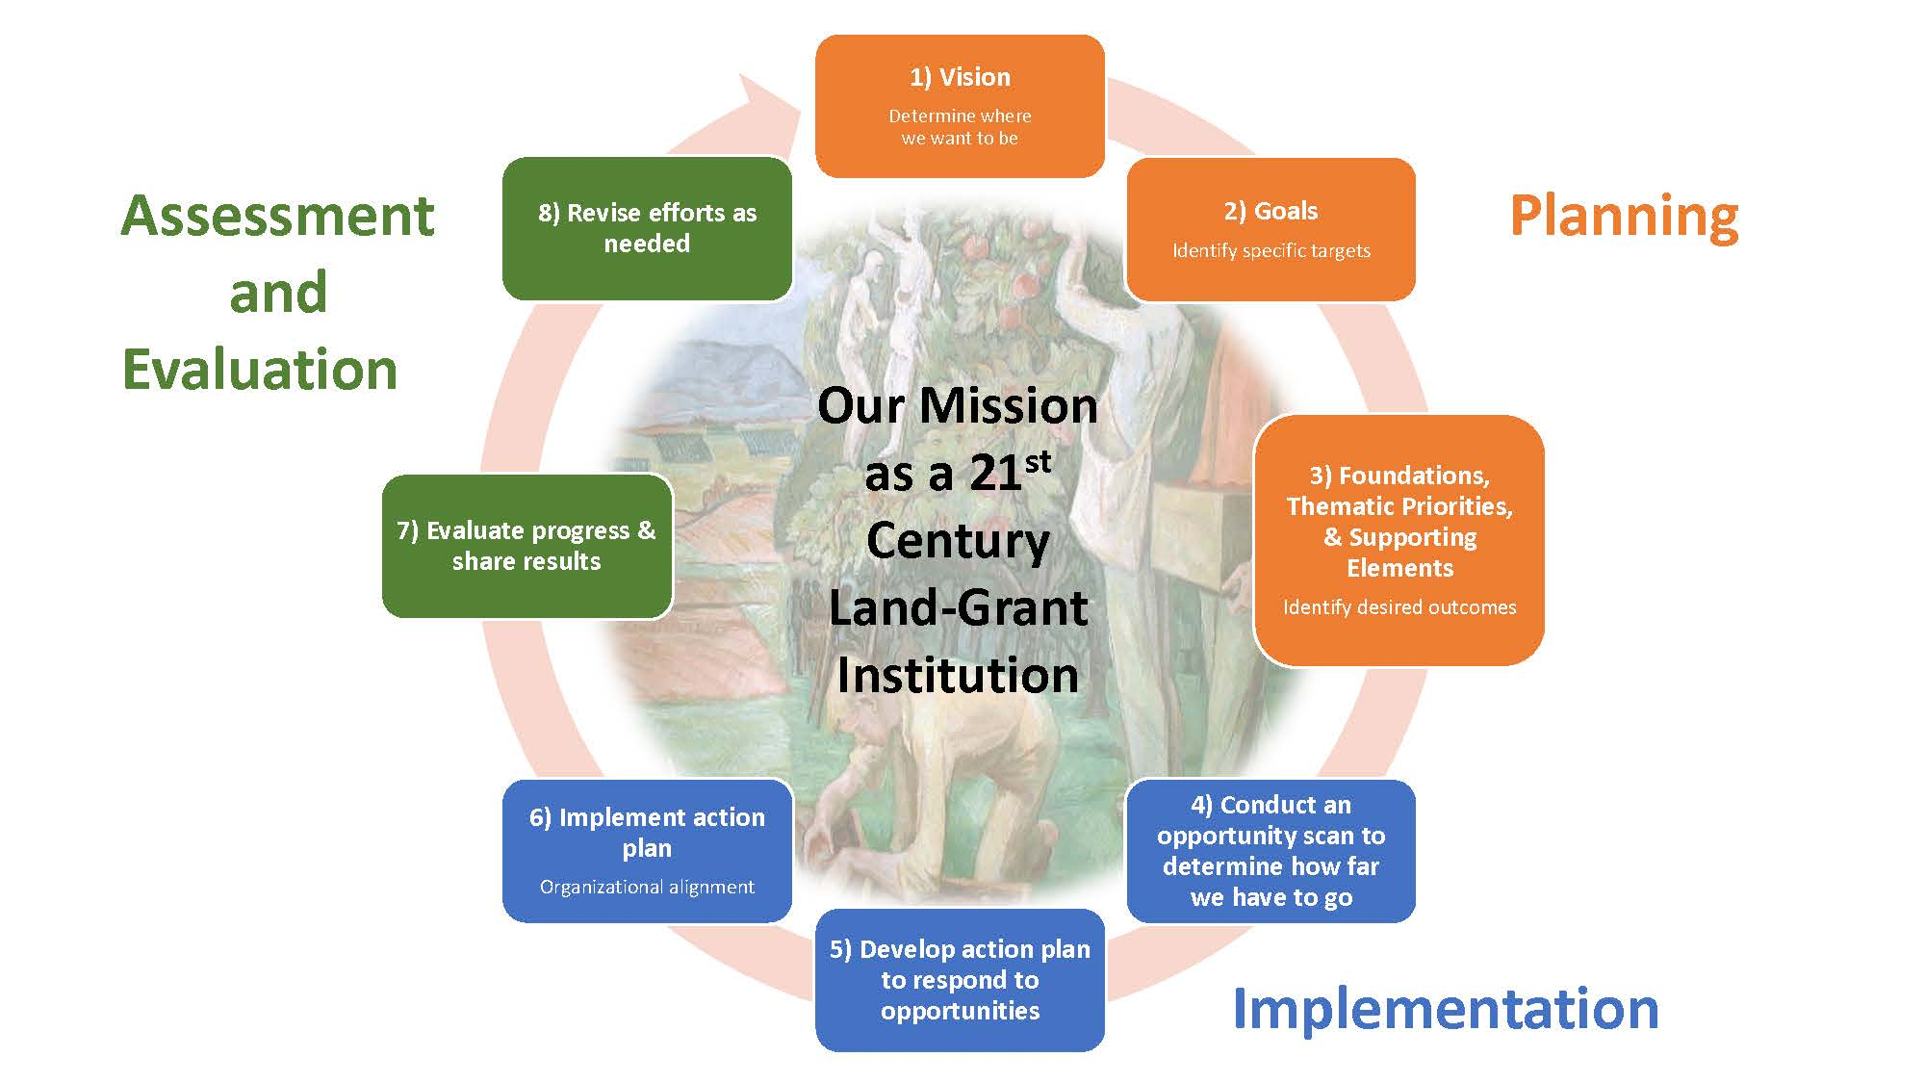
Our Strategic Planning Process
OFFICE OF THE EXECUTIVE VICE PRESIDENT AND PROVOST
Notes:
So, that’s a quick summary of Penn State’s strategic plan. The strategic planning process, however, goes far beyond writing the plan. Implementing it is a complex endeavor that is already under way and will continue during the next four years. I will go into more detail about this process now.
An impactful strategic plan must roll out in three major phases:
Development,
Implementation, and
Assessment.
The sections you see here in orange are reflected in our written plan.
Now we are moving forward with plan implementation, the steps in blue. Those are coupled with assessment and evaluation efforts, shown in green.

Slide 13
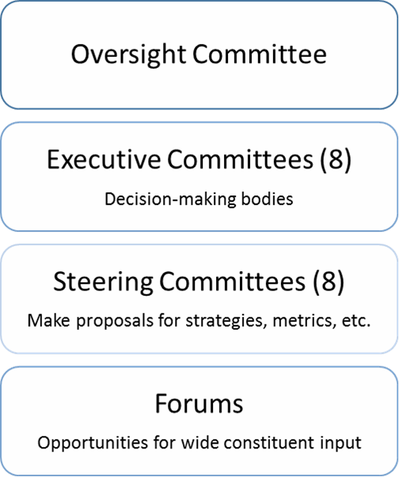
Plan Implementation Structure
OFFICE OF THE EXECUTIVE VICE PRESIDENT AND PROVOST
Notes:
Because implementing our strategic plan is a complex, multi-year process, we created a committee structure to make it more manageable. One oversight committee manages the work of eight executive committees – the decision-making bodies. They, in turn, manage eight corresponding steering committees, which develop and make plan-related recommendations and proposals. Community forums such as today’s gathering will enable valuable constituent input and feedback to reach our committees and inform their work throughout the implementation process.

Slide 14
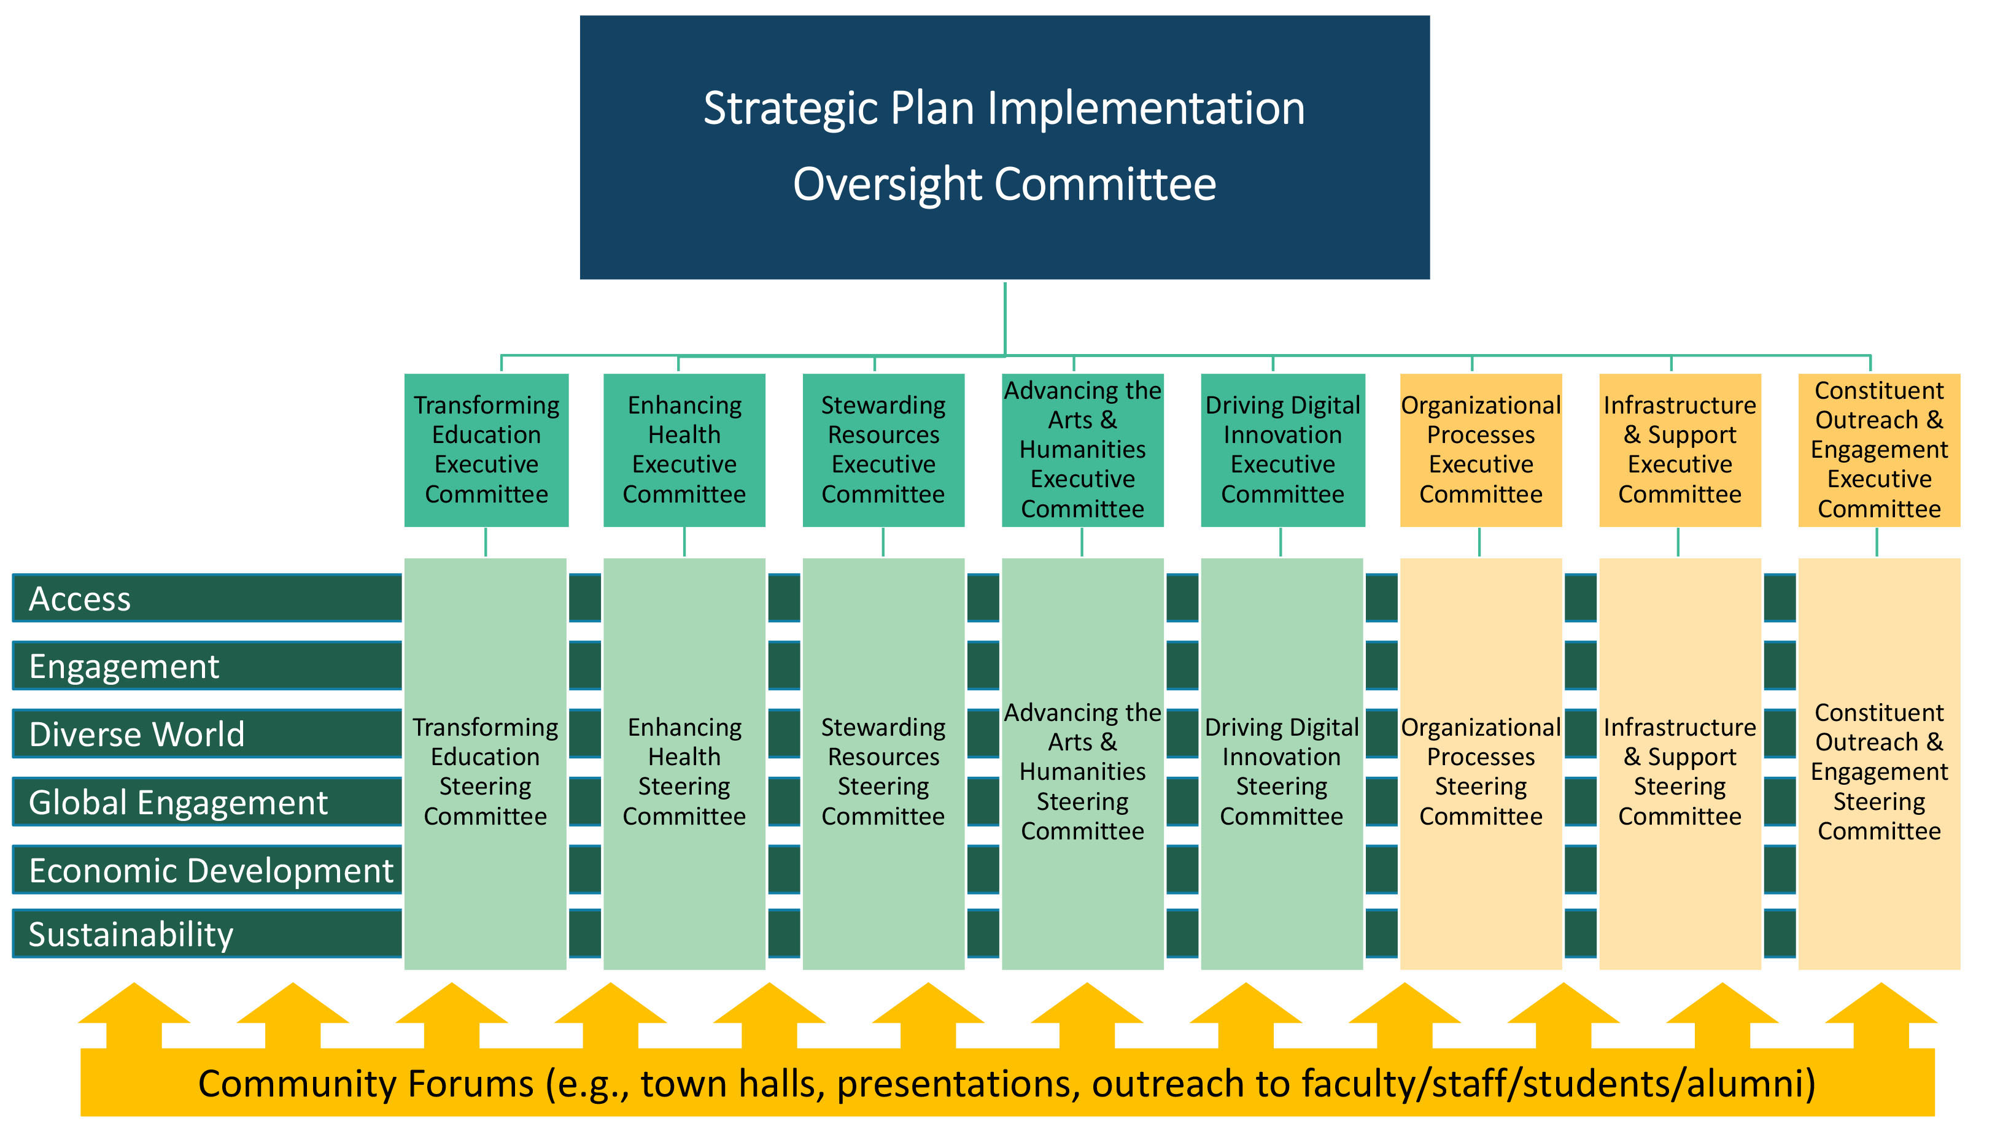
Implementation Structure Detail
OFFICE OF THE EXECUTIVE VICE PRESIDENT AND PROVOST
Notes:
This graphic shows the layered committee structure we built to implement our plan. The oversight committee, shown at the top, oversees the work of eight executive committees and their supporting steering committees.
Each executive and steering committee aligns with a thematic priority or supporting element articulated in the strategic plan. The foundations, shown on the left side of this graphic, are integral to all components of the plan, so they drive all of the committees’ efforts. Feedback gleaned from community forums informs the committees’ efforts from the bottom up.

Slide 15
The Committees’ Charges
One Oversight Committee
Chaired by the Provost; drives implementation throughout Penn State
Delivers regular progress reports to Board, University leaders
Eight Executive Committees
Aligned with plan’s thematic priorities and supporting elements
Prioritize efforts and identify and direct resources to support them
Eight Steering Committees
Recommend initiatives and action plans; facilitate community forums
OFFICE OF THE EXECUTIVE VICE PRESIDENT AND PROVOST
Notes:
So, how do these committees differ regarding their charges – the work they are being asked to do?
The Oversight Committee, which I chair, ultimately drives the implementation process throughout Penn State. It will deliver regular progress reports to me, the Board of Trustees, and other University leaders.
The executive committees include leaders from throughout the University who have relevant experience and expertise and the capacity to transform our goals into ambitious – but still achievable – strategies and outcomes. These committees and their members are being asked to:
provide regular updates to the Oversight Committee;
review and support the goals, initiatives, strategies, and metrics proposed by their corresponding steering committees;
prioritize efforts related to their topical areas; and
identify and direct resources to support those efforts.
Meanwhile, the steering committees, which report to their corresponding executive committees, are being asked to:
develop initiatives related to targeted areas of opportunity;
establish specific goals and objectives and action plans for achieving them;
identify and track performance indicators;
ensure that the plan’s foundations are woven throughout the goals, initiatives, strategies, and metrics they propose to their executive committees; and
facilitate public forums to engage faculty, staff, students, and alumni in the plan’s implementation.
All of the committees are already engaged and working in their topical and functional areas. In conjunction with representatives of the Office of Planning and Assessment, they are developing action plans, making recommendations, and writing and submitting thorough reports about their work.

Slide 16
Incorporating the Foundations
Each foundational area has a representative on each steering committee.
The units responsible for identifying these representatives (e.g., Global Programs for Global Engagement) will coordinate periodic meetings to ensure a holistic approach to including the foundational areas in plan implementation.
Each foundational area representative is responsible for working with his or her steering committee and periodically with other members of their foundational area.
OFFICE OF THE EXECUTIVE VICE PRESIDENT AND PROVOST
Notes:
I should add that every foundational area identified in the strategic plan has a representative on each steering committee. The units responsible for identifying these representatives – such as the Office of Global Programs, for the foundation related to Global Engagement – are holding meetings to ensure a holistic approach to including the foundations in plan implementation.
Each foundation representative is responsible for working with his or her steering committee and periodically with other members focused on their foundational area.

Slide 17
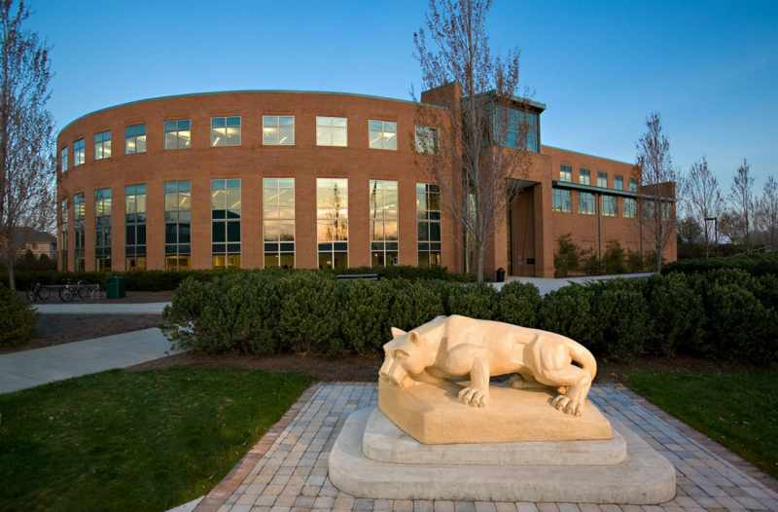
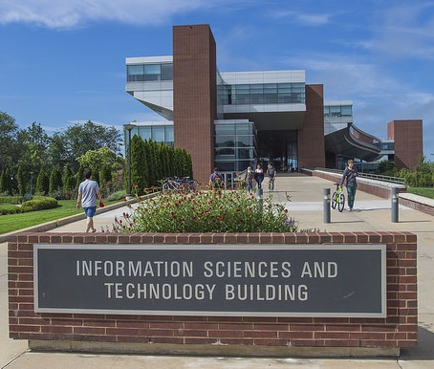
Aligning with Unit Strategic Plans
Remember: The over-arching strategic plan was developed after
48 academic and administrative units across the University wrote their plans.
OFFICE OF THE EXECUTIVE VICE PRESIDENT AND PROVOST
Notes:
We put a lot of structure around implementation, which makes sense because our strategic planning processes are not haphazard endeavors. The over-arching strategic plan emerged after 48 academic and administrative units wrote their strategic plans. This process was essential to ensure alignment – to make sure that, as much as possible, we are all “on the same page.”

Slide 18
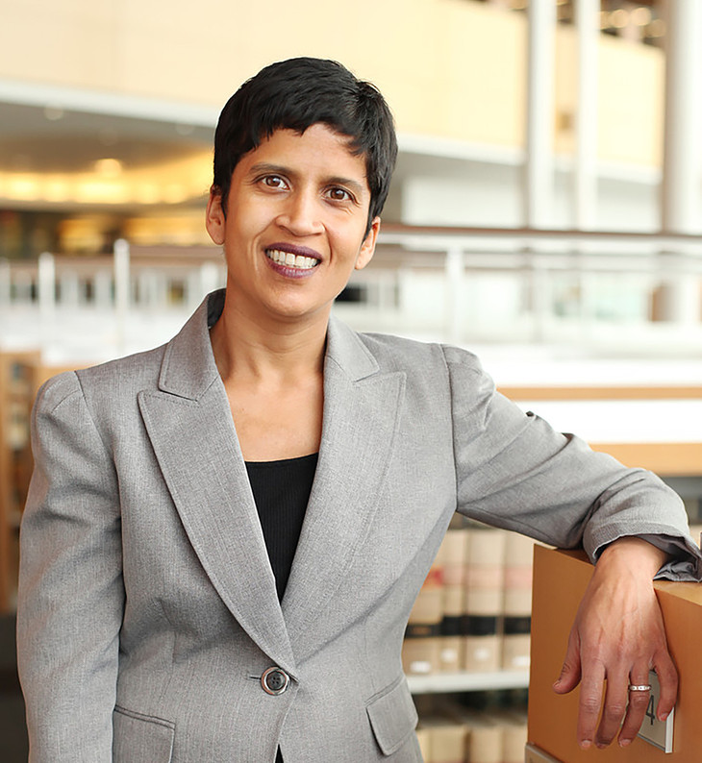
Unit Alignment and Progress Reports
Unit updates will include information about:
  Alignment with the University’s plan
  Support of the University’s goals
  Outcomes and successes
  Challenges and concerns
  Any changes to original unit strategic plans
Annual unit progress reports are due
in May 2017.
OFFICE OF THE EXECUTIVE VICE PRESIDENT AND PROVOST
Notes:
Throughout the multi-year process, all Penn State units will report regularly on:
their alignment with the strategic plan,
contributions to Penn State’s goals,
outcomes and successes,
challenges and concerns, and
any modifications to their own strategic plans.
These reports will help the committees implement a focused, data-driven plan. Official annual progress reports for all units are due next May.

Slide 19
Plan Implementation Activities and Timeline
Fall 2016
  Steering committee meetings and community forums begin.
  Unit implementation plans due; unit-level support/training ongoing
  Updates to strategic plan website about implementation process
Spring 2017
  Committees provide annual updates.
  Units develop and complete annual reports.
  More community forums are held at several Penn State campuses.
OFFICE OF THE EXECUTIVE VICE PRESIDENT AND PROVOST
Notes:
Our strategic planning timeline for this semester and next semester notes these reports and other deliverables, including relevant updates throughout the process. We will post these regularly on the strategic plan website.

Slide 20
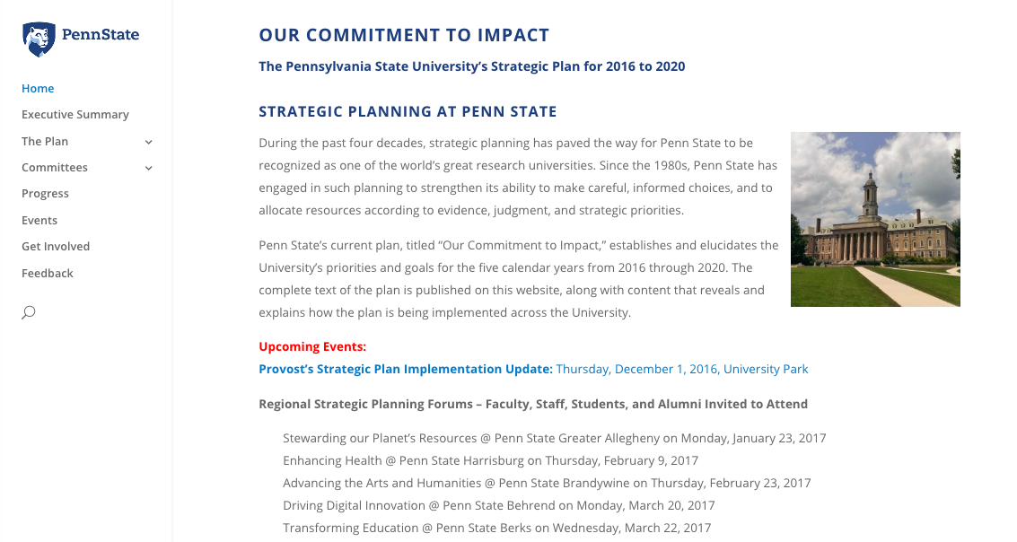
Website Updates / New Sections
strategicplan.psu.edu
OFFICE OF THE EXECUTIVE VICE PRESIDENT AND PROVOST
Notes:
Speaking of the website, we have updated it in recent weeks to contain not only the text of the plan, but also several new sections. This recent screenshot reveals an expanded left-side menu with pages related to detailed information about the implementation committees and their work. Other new sections are devoted to progress reports on plan implementation, related events, and ways for people to get involved and provide feedback.
The website is being updated regularly with all plan-related event information, including forums we are planning early next year at several of our Commonwealth Campuses. With the help of our strategic communications team, we will promote those events through all of our relevant news and social media platforms.
We’ll also be using the home page to feature stories that show how the plan is being implemented across the University. Look for the first stories to be showcased online in the coming week.

Slide 21
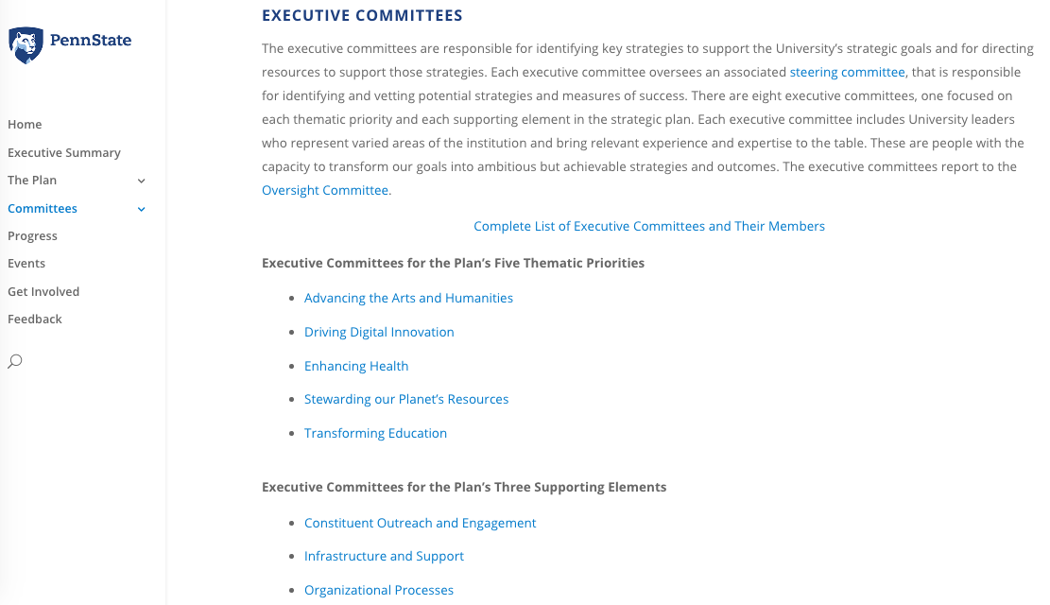
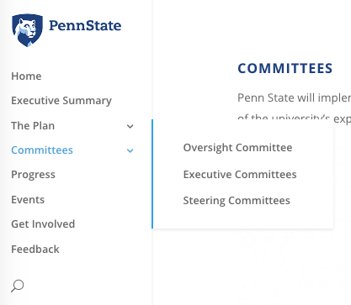
Finding Committee Information
Use the Committees menu to find complete membership lists.
OFFICE OF THE EXECUTIVE VICE PRESIDENT AND PROVOST
Notes:
Regarding the implementation committees and related information, I want to spotlight the Committees drop-down menu on the updated plan website. In this section, you can download PDFs that list members of all of the executive and steering committees. If you want to know who is serving on a committee focused on a specific thematic priority or supporting element, you can simply click on the appropriate link to access that information.

Slide 22


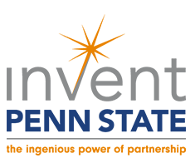
Examples of the Plan in Action
OFFICE OF THE EXECUTIVE VICE PRESIDENT AND PROVOST
Notes:
So, strategic plan implementation is well under way, with people engaged in the process across the University. However, one of the most common questions I get involves what implementing the plan “looks like” in real time. What is actually happening at Penn State that reflects the content of our strategic plan and showcases our commitment to executing it?
Our strategic plan is already providing a strong foundation from which to work and get meaningful things done. Every day we are building on existing areas of strength and activity.
Examples abound of initiatives and success stories that show how we are already operationalizing the strategic plan across Penn State. Among them are:
All In – Our University-wide diversity and inclusion initiative kicked off in October with a spectacular multimedia presentation projected onto the front of Old Main in University Park. The event was live-streamed to the Commonwealth Campuses.
Invent Penn State – This already popular and impactful initiative offers resources and opportunities to collaborate, innovate, invest, or grow a business.
100&Change – We are submitting a proposal to the MacArthur Foundation regarding this new competition, which ultimately will award a $100 million grant to one project or initiative designed to help solve a critical global problem.

Slide 23
Living the Plan Every Day
Recent news related to just one thematic priority: Enhancing Health
New Penn State Health and Wellness Center in University Park
$20,000 grant to UPUA to explore smoke-free-campus initiatives
Student ambassadors sought for new “Healthy Penn State” initiative
Researchers in the College of Health and Human Development focusing on ways to drive behavior change that will improve community health
College of Education support of CEDAR Clinic to spread awareness about and raise funds for student mental health programs (This week also happens to be Mental Health and Wellness Week at Penn State.)
OFFICE OF THE EXECUTIVE VICE PRESIDENT AND PROVOST
Notes:
Countless other examples, large and small, show how the University is supporting and driving the strategic plan in meaningful ways. Consider just one of our strategic plan’s thematic priorities: Enhancing Health.
We state that, “Penn State will be a leader in promoting quality of life through comprehensive approaches to enhancing personalized and population health, achieved through a commitment to and investment in relevant research, education, clinical practice, and outreach.”
The crux of this priority is recognition of the multiple factors that contribute to overall health – including individual biology and behaviors, the contexts in which people live and work, the quality of their health care, and public health policies and programs.
It is an important and ambitious priority, and recent news shows how we’re driving it across Penn State.
The University is constructing the Penn State Health and Wellness Center, a faculty and staff health clinic on the first floor of the Nursing Sciences Building. Starting in January, the clinic will provide University Park employees with care for minor health issues, ranging from coughs and colds to scrapes and bruises using the skills of nurse practitioners and Penn State Health physicians.
Also, announced last month by the American Cancer Society, the University Park Undergraduate Association was awarded a $20,000 grant toward a student-led effort to explore smoke-free initiatives. Penn State is one of only 20 colleges and universities to receive such a grant.
In addition, University Health Services recently announced that it is seeking student ambassadors for its new “Healthy Penn State” initiative.
Meanwhile, researchers in the College of Health and Human Development are focusing on ways to drive behavioral change and improve community health. With support from the National Prevention Science Coalition, they have launched a pilot program for building collaborations between scientists and policy makers – all to translate behavioral prevention strategies into meaningful, evidence-based policy.
Finally, earlier this week, the College of Education partnered with the Office of Annual Giving for “Giving Tuesday.” It chose CEDAR Clinic as its beneficiary to spread awareness and raise funds for student mental health. This week also happens to be Mental Health and Wellness Week at Penn State.
Keep in mind that these are only a few examples of efforts that support just one part of our comprehensive strategic plan. And, these are the types of stories you’ll soon see featured on the home page of the strategic plan website.

Slide 24
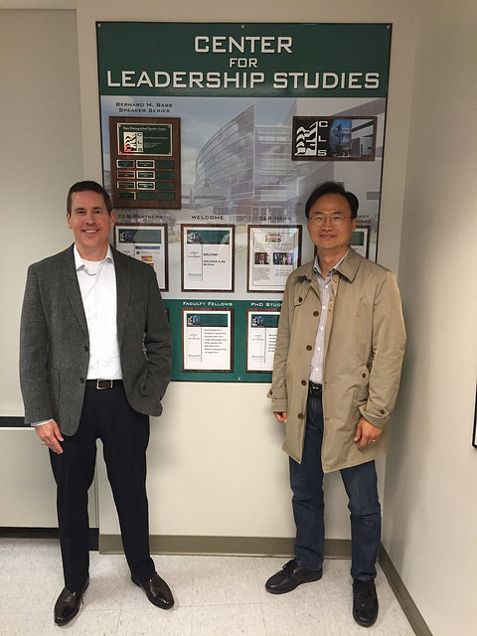
Our Vast and Vital Call to Action
What We’re Asking of Our Leaders:
Connect plan strategies to daily work
Be engaged, accountable, communicative
Embrace change and feedback
Key Message:
Without their focused leadership,
Penn State cannot achieve its desired outcomes.
OFFICE OF THE EXECUTIVE VICE PRESIDENT AND PROVOST
Notes:
Moving forward, our call to action is clear. While developing our strategic plan was a University-wide effort, implementing it is, as well. I have met with many groups of Penn State leaders in the past few months to explain what is expected of them.
I am asking key stakeholders on all of our campuses – and in all of our colleges, departments, and operating units – to connect our strategies to their day-to-day activities and efforts like the health-related ones I referenced.
I am asking them to be engaged, accountable, communicative, and receptive to feedback and change.
And I am reminding them that, without their leadership, we will not achieve our desired outcomes.
I will be reinforcing these messages often during the next four years.

Slide 25
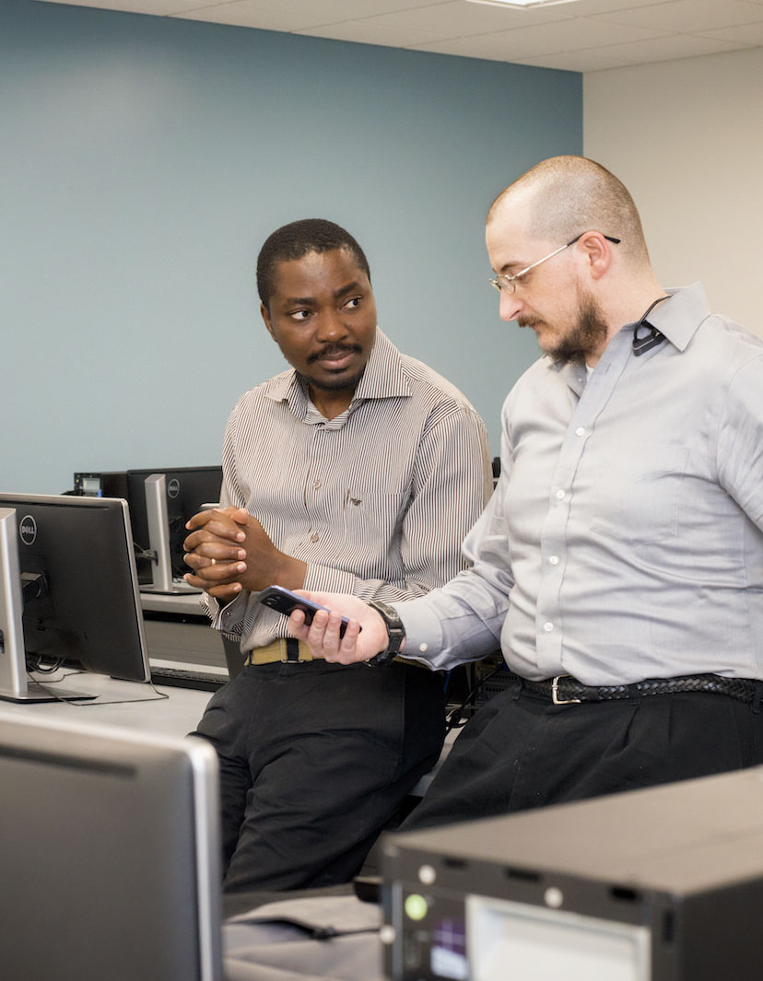
From Plan to Action to Impact:
Key Takeaways
The University is continuing its decades-long focus on strategic management.
Penn State is well situated to maintain and even advance its position among the world’s top research universities.
The University’s agile, adaptive plan lays out in broad strokes the basis for future, successful actions toward that end.
OFFICE OF THE EXECUTIVE VICE PRESIDENT AND PROVOST
Notes:
Ultimately, it is also important for everyone to know that our current planning efforts are a continuation of the University’s longtime focus on strategic management. Because of this approach over the past 40 years, Penn State is well situated to maintain and even advance its position among the world’s top research universities. Our current plan is agile and adaptive, laying out in broad strokes the basis for future, successful actions toward that end.

Slide 26
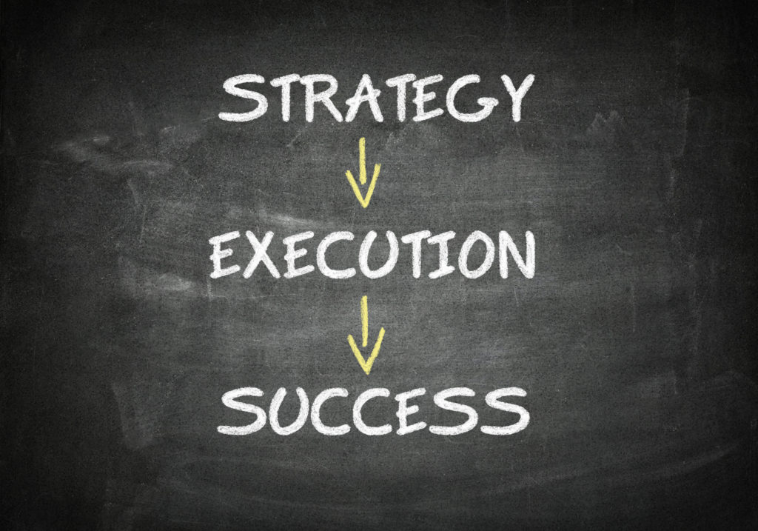
What Planning Can Deliver, Enable
By identifying Penn State’s goals at a high level, it establishes a strong foundation for their pursuit.
The elements are in place to extend the University‘s reach and impact during a period of disruptive change.
Exceptional teaching, research, and service remain essential.
OFFICE OF THE EXECUTIVE VICE PRESIDENT AND PROVOST
Notes:
Strategic planning is essential for an institution of our size and scope. By identifying Penn State’s goals at a high level through our University-wide plan, we established a strong foundation for their pursuit and implementation.
We have the pivotal pieces in place to extend the University‘s reach and impact during what we all recognize is a period of disruptive change. Throughout this time, exceptional teaching, research, and service remain essential – as the strategic plan’s mission statement makes clear.

Slide 27
How You Can Get Involved
Reach out to strategic plan implementation committee members to share your thoughts and expertise. What ideas do you have?
Attend events like this one and other strategic planning forums to interact with committee members and provide feedback.
Monitor updates to see how we are doing – at strategicplan.psu.edu and by reading stories via Penn State’s news and social media platforms.
Contact the Office of Planning and Assessment with any questions and comments you may have throughout the process.
OFFICE OF THE EXECUTIVE VICE PRESIDENT AND PROVOST
Notes:
Penn State and other institutions of higher learning are facing significant and fundamental challenges that often lack clear or easy solutions. There are no silver bullets or one-size-fits-all answers for addressing these challenges, but we are determined to get useful input from people University-wide to identify and deploy appropriate solutions.
Collaboration across the enterprise will be key to our success. So, how can you get involved? Attending events like this one is a great place to start. Also:
Reach out to implementation committee members to share your thoughts and expertise. What ideas do you have to help Penn State succeed?
Attend future strategic planning forums to interact with committee members and provide feedback.
Monitor updates to see how we are doing – at strategicplan.psu.edu and by reading stories via Penn State’s news and social media platforms.
And, contact the Office of Planning and Assessment with any questions and comments you may have.

Slide 28


Thank You.
Questions and Comments
provost.psu.edu
OFFICE OF THE EXECUTIVE VICE PRESIDENT AND PROVOST
Notes:
Thank you for your time today and your interest and engagement in our strategic planning efforts
It’s a great time to be at Penn State.
Now, I would like to take some time to address your questions or comments.
END REMARKS/OPEN Q&A PERIOD

